Slide 1

Tim Poulsen
Software Engineer
R&D Team
ACV Labs

Slide 2
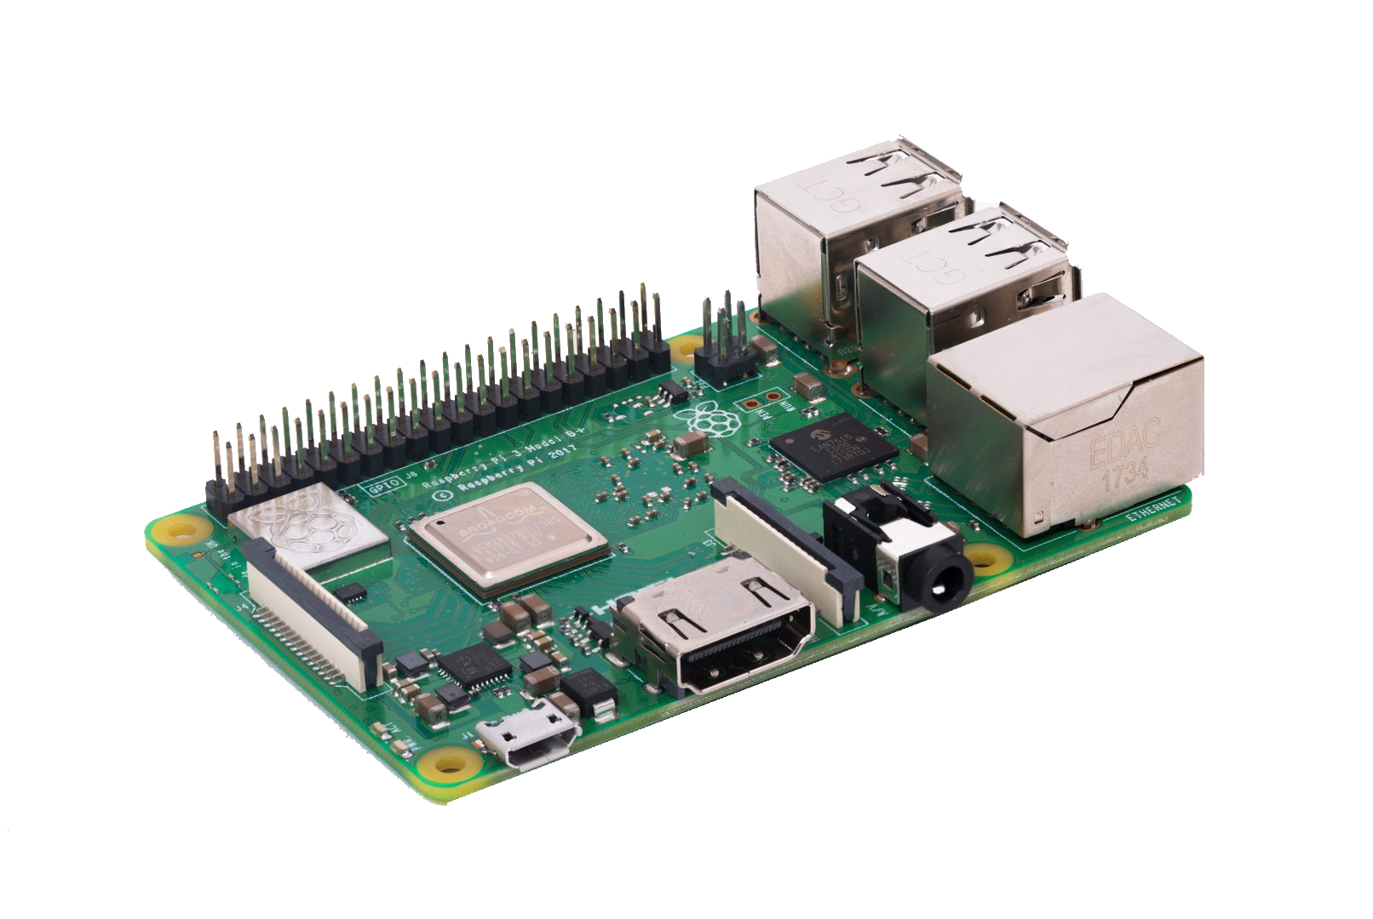
Raspberry Pi
Overview & Examples
Board components
Basic setup
Python dev
Libraries
Resources

Slide 3
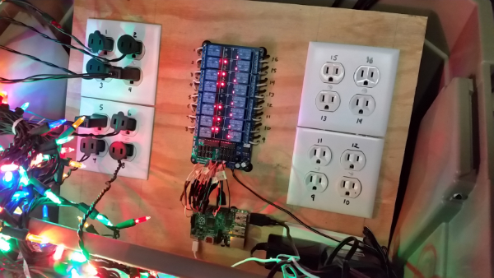

https://github.com/skypanther/PiLit

Slide 4
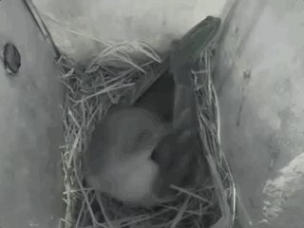
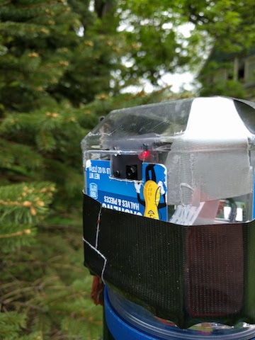
https://www.timpoulsen.com/2018/pi-birdcam.html

Slide 5
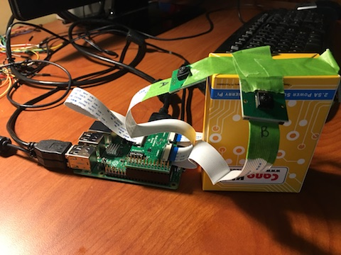
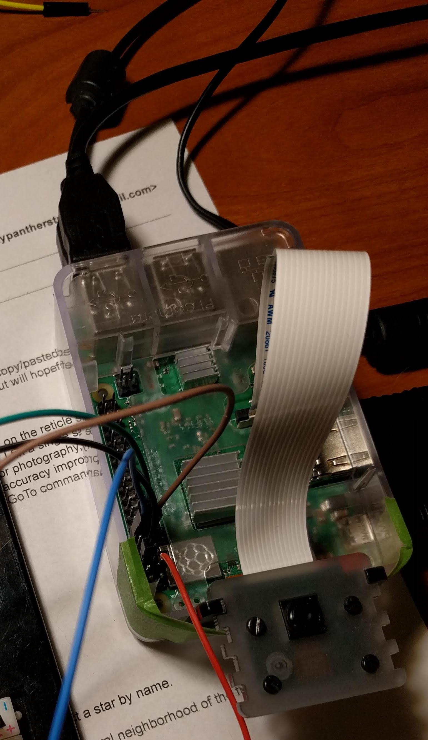
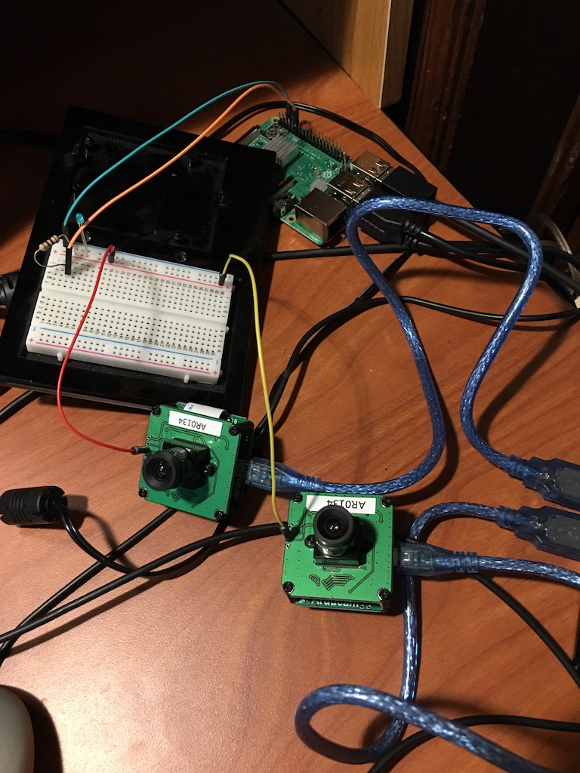
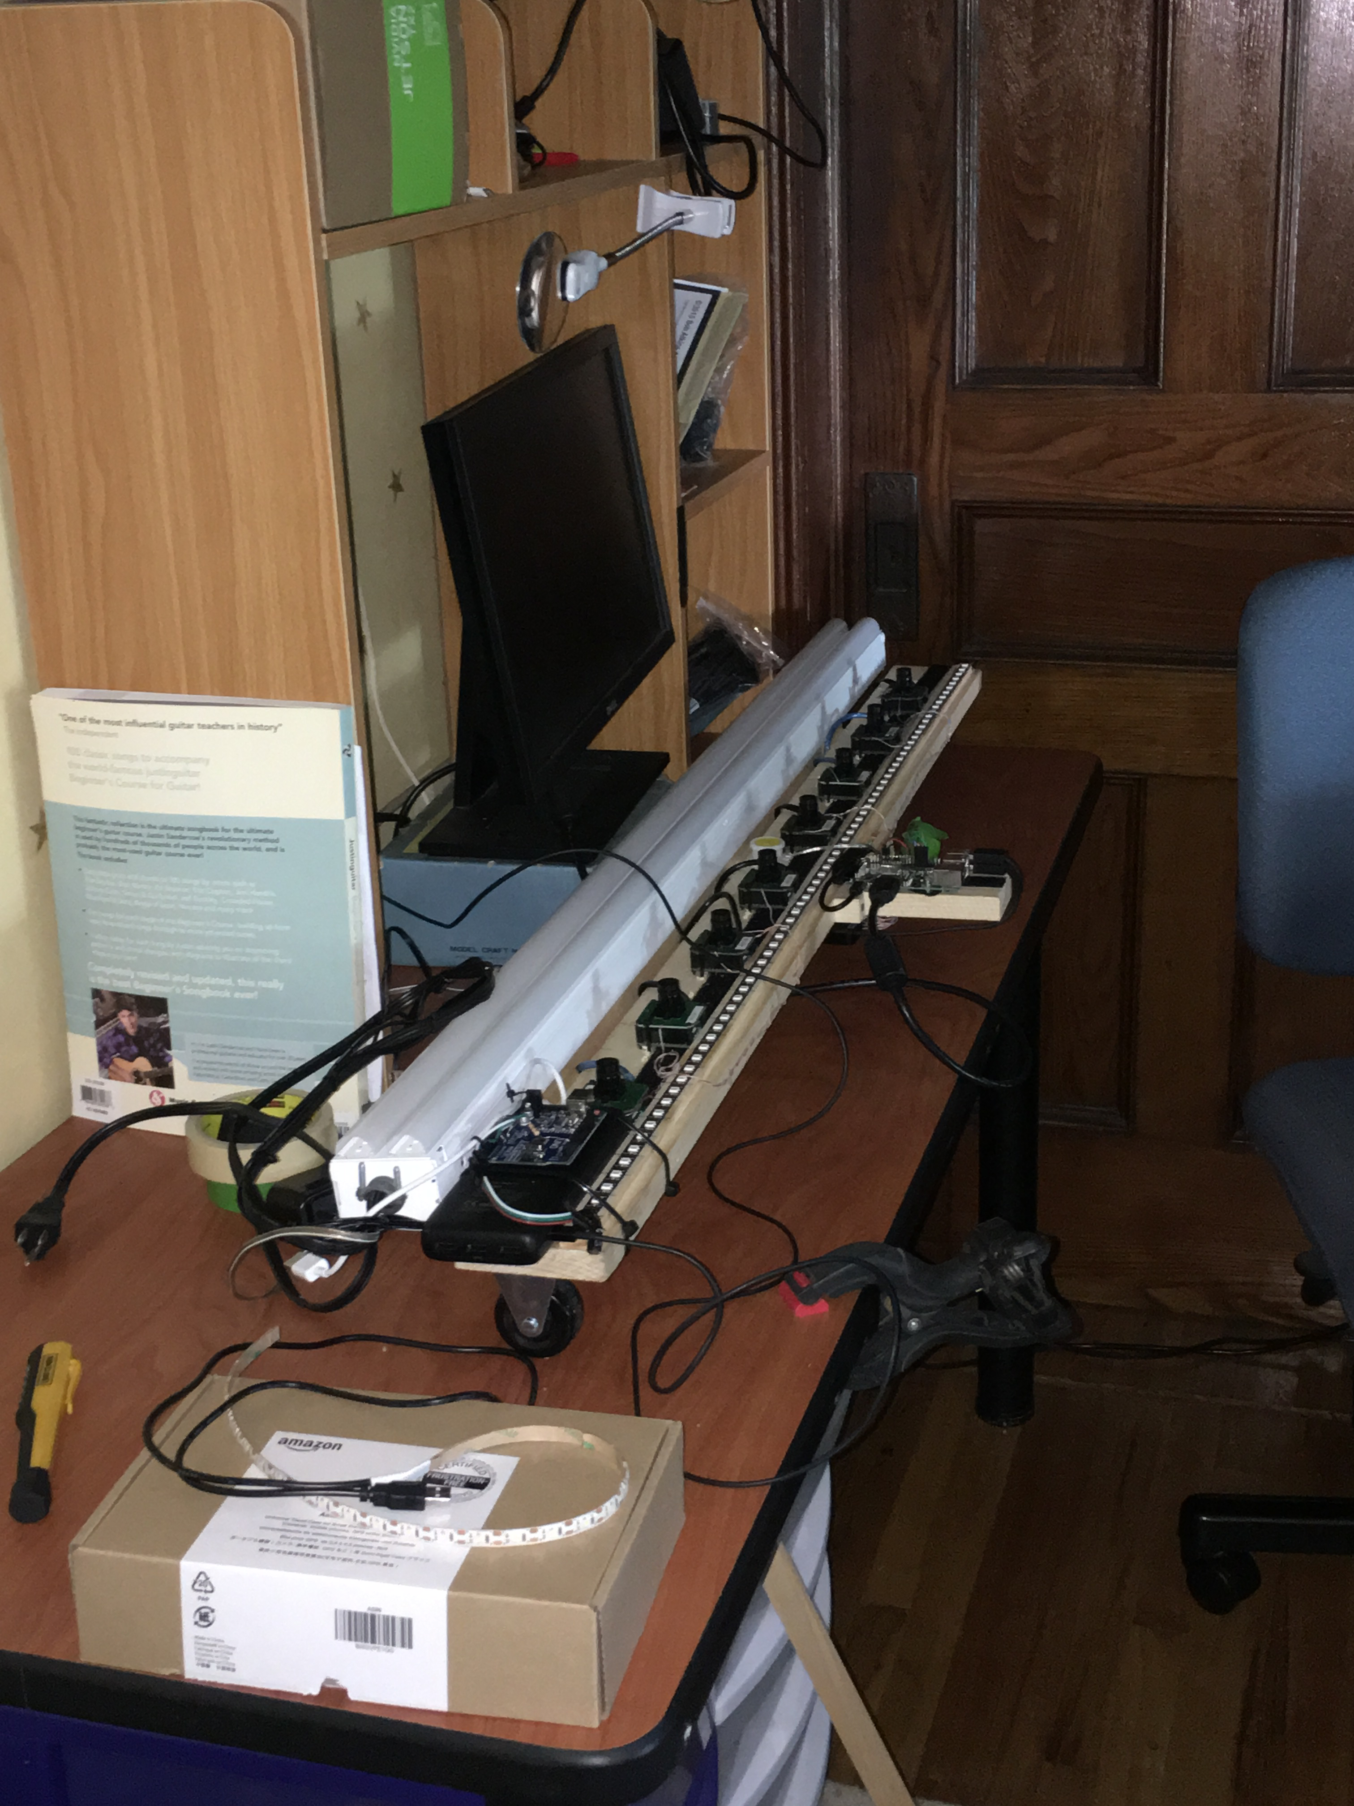
Camera controller board

Slide 6
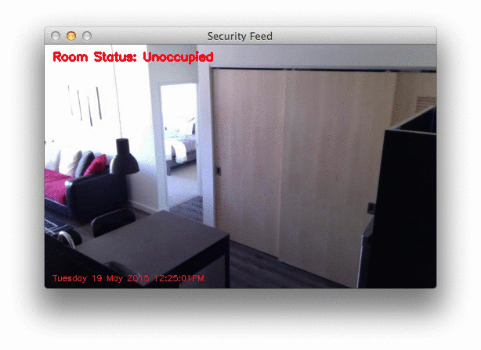
PyImageSearch blog
www.pyimagesearch.com/2015/05/25/basic-motion-detection-and-tracking-with-python-and-opencv/

Slide 7
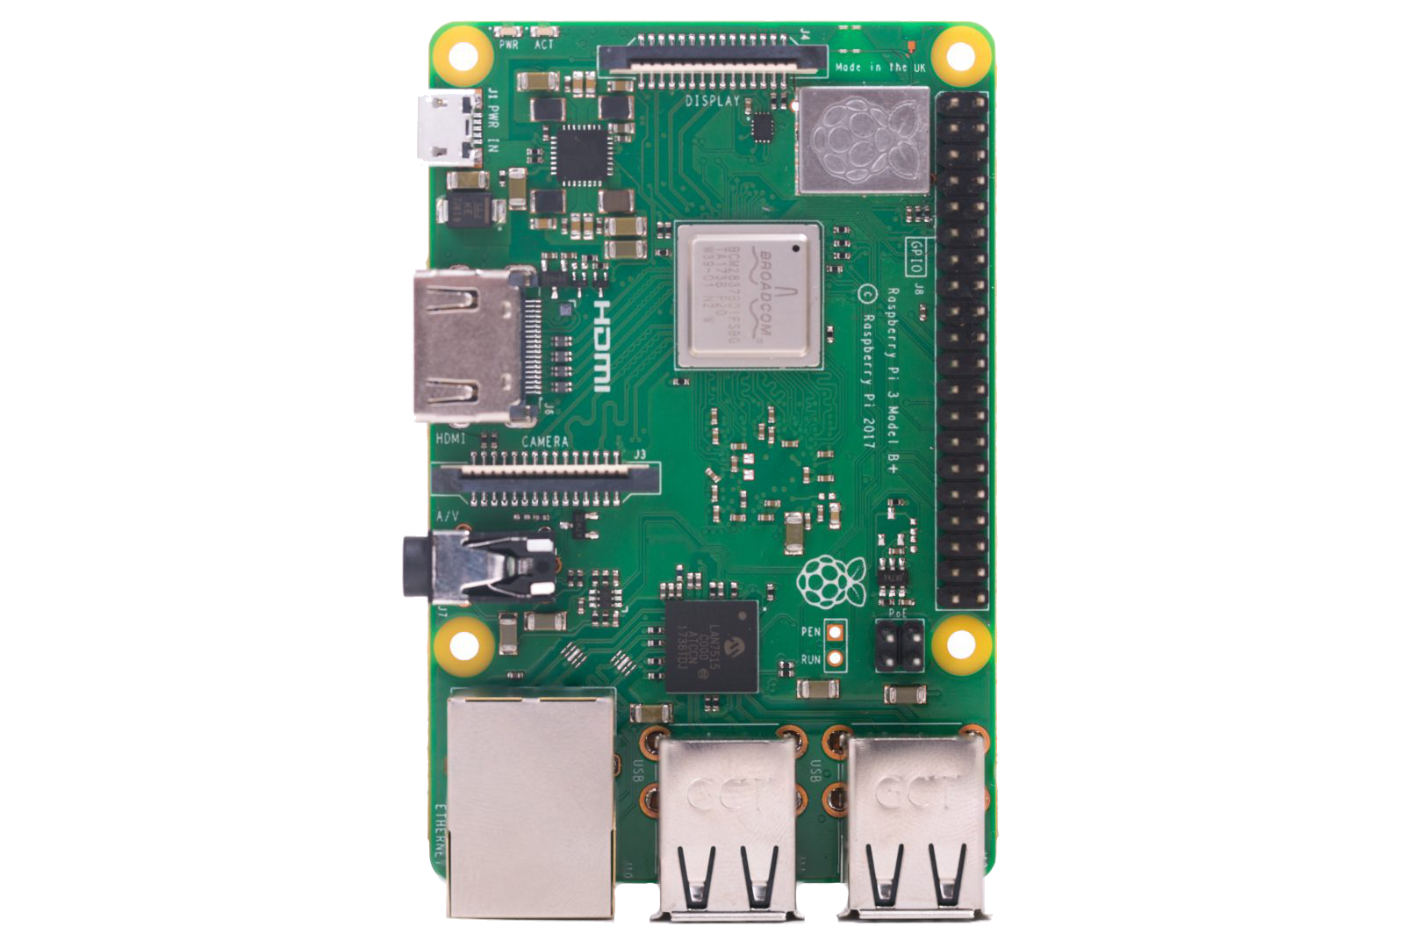
Pi 3b+
Micro SD slot (back side)
Power in (micro-USB)
HDMI
GPIO, I2C, serial
CSI camera
Stereo audio out
Broadcom BCM2837B0, Cortex-A53 (ARMv8) 64-bit SoC @ 1.4GHz
1GB LPDDR2 SDRAM
2.4GHz and 5GHz IEEE
802.11.b/g/n/ac
Bluetooth 4.2, BLE
Gigabit Ethernet
4 x USB 2.0

Slide 8
OS Options
Raspbian (customized Debian distro)
NOOBs - an installer, not an OS
Third-party provided Ubuntu, Windows 10 IoT Core, RISC OS, etc.

Slide 9

OS Setup
Download OS “image” .img file
Copy to SD card
Insert in Pi and boot
Etcher app - https://www.balena.io/etcher/

Slide 10
Dev Environment
Python 2.x / 3.x
C
C++
Java
Scratch
Ruby
Wolfram language
SonicPi
Git

Slide 11
IDEs
Pre-installed:
Thonny (Python)
Geany (multiple)
BlueJ (Java)
Greenfoot (Java)
Mathematica
Node-RED
Scratch
Installable:
VS Code - https://code.headmelted.com/
Spyder
Ninja-IDE
Lazarus
lots more…

Slide 12
Python Libraries
Pre-installed:
RPi.GPIO
GPIO Zero
PiCamera
Installable:
Any Python-only library
Or, any that will compile for ARM
www.piwheels.org - precompiled packages
e.g. OpenCV, Tensorflow, WiringPi, etc.

Slide 13
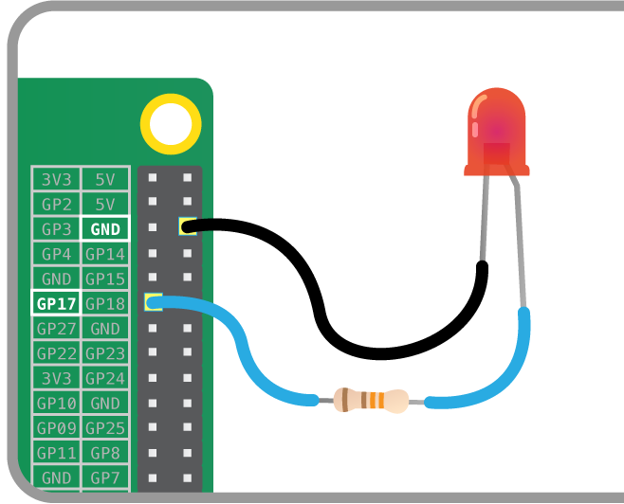
GPIO Basics
from gpiozero import LED
from time import sleep
red = LED(17)
while True:
red.on()
sleep(1)
red.off()
sleep(1)

Slide 14
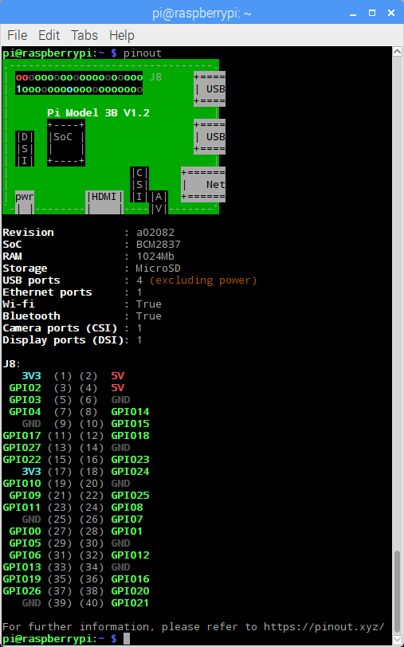
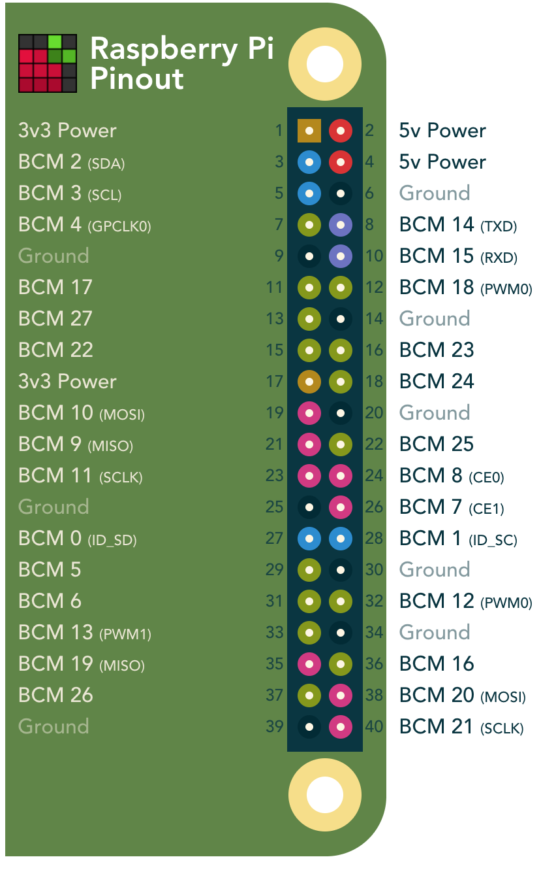
GPIO / I2C / Serial
https://pinout.xyz/

Slide 15
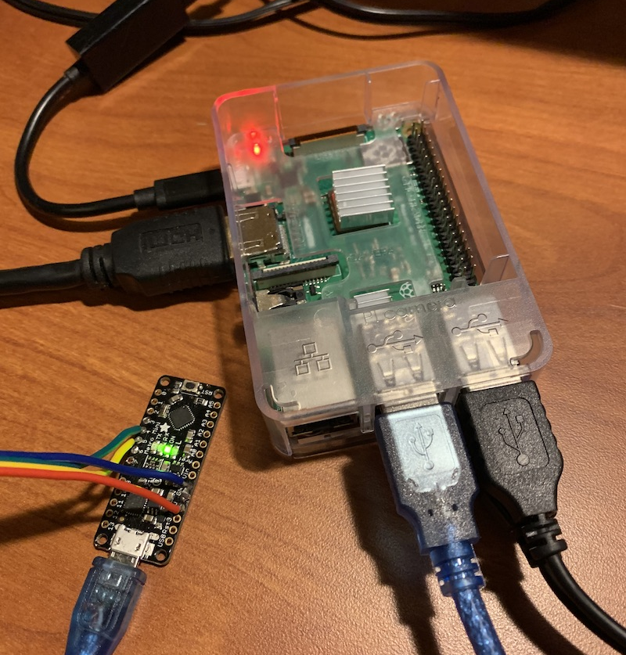
Serial over USB
import serial
# open serial port
ser = serial.Serial('/dev/ttyUSB0')
# write a string
ser.write(b'hello')
# close port
ser.close()

Slide 16
PiCamera
from picamera import PiCamera
from time import sleep
camera = PiCamera()
camera.resolution = (1024, 768)
camera.start_preview()
# Camera warm-up time
sleep(2)
camera.capture('foo.jpg')

Slide 17

Thanks!
timpoulsen.com
github.com/skypanther
@skypanther
www.linkedin.com/in/timpoulsen

